Slide 1
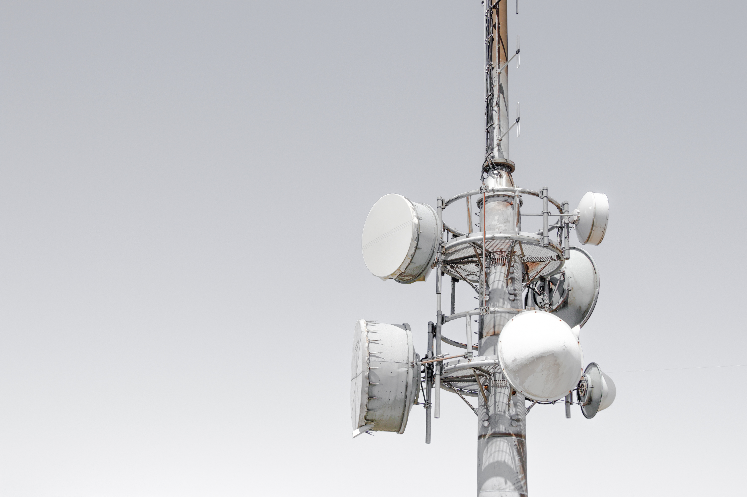
Cellular
Networks
MAHARSHI BHAVSAR - 11
MIHIR DARJI - 13
Image from Unsplash

Slide 2
Why?
Communication
Over long distances
Mobility

Slide 3
What does it provide?
Hierarchical structure
Large geographical coverage area
Reduced interference
Transparent handovers
Roaming

Slide 4
How does it work?

Slide 5
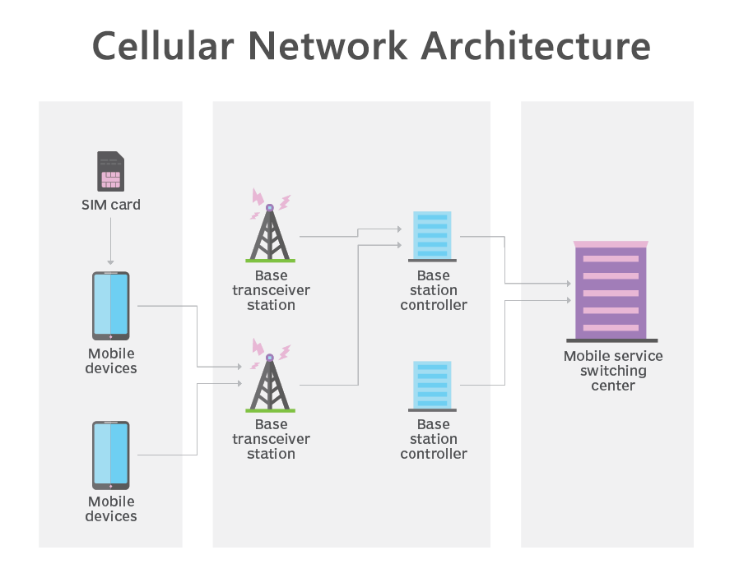
Image from TechTarget

Slide 6
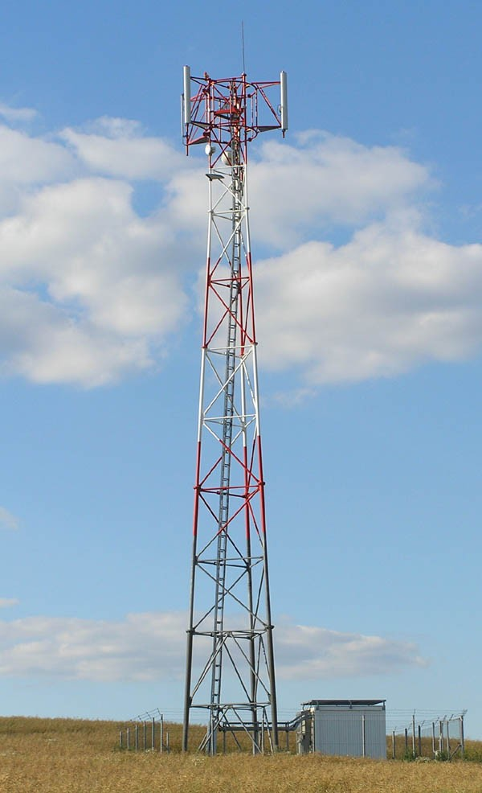
Base Transceiver Station
Facilitates connection between mobile stations and the network
Houses encryption-decryption equipment, bandpass filters, antennas
Several transceivers with varying frequencies

Slide 7
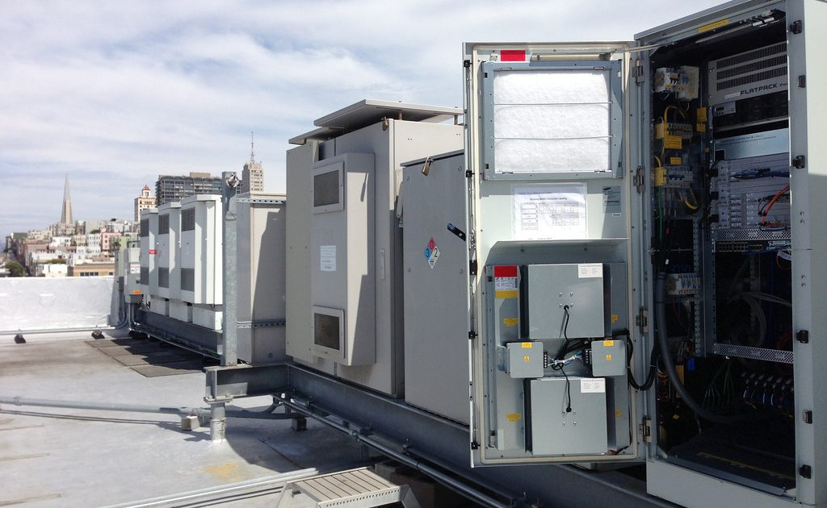
Base Station Controller
The intelligence behind the BTSs
Controls from 10-100 BTSs
Handles allocation of radio channels, receives signal strength info from mobile stations
Transparent load balancing

Slide 8
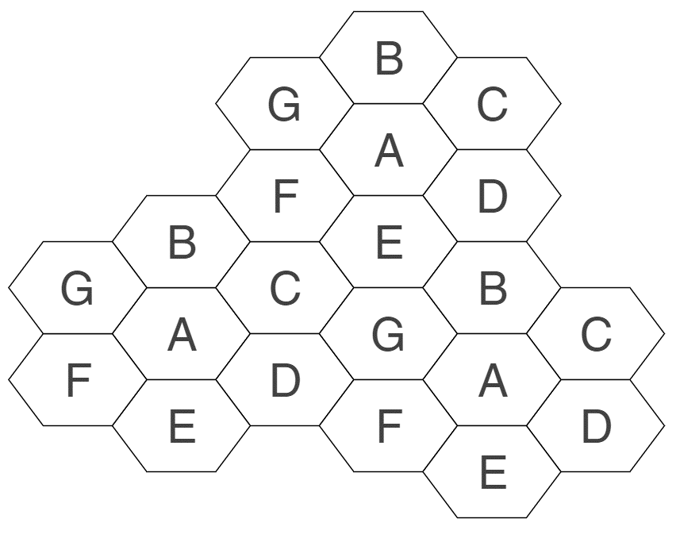
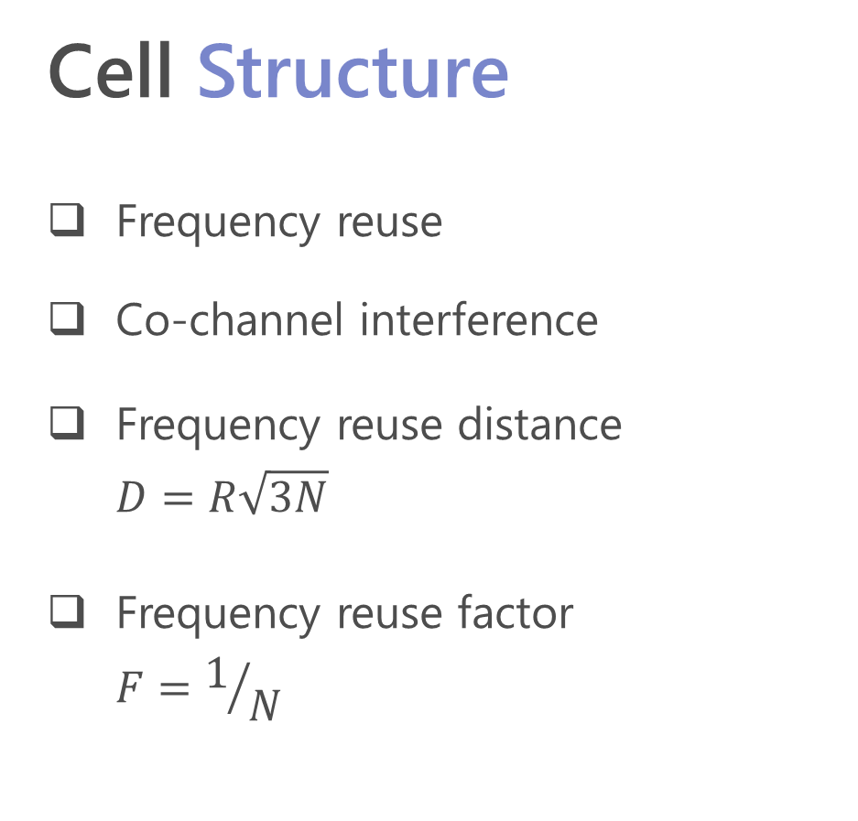
Cell Structure
Frequency reuse
Co-channel interference
Frequency reuse distance
$$D=R\sqrt{3N}$$
Frequency reuse factor
$$F=1/N$$

Slide 9
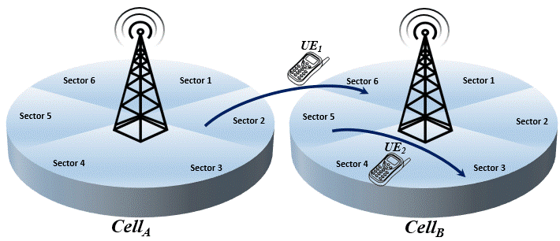
Handover
Changing the point of connection while communicating
Intra-cell or Inter-cell
Happens when:
mobile station is gradually going out of range
extra load on current BTS
Image from ResearchGate

Slide 10
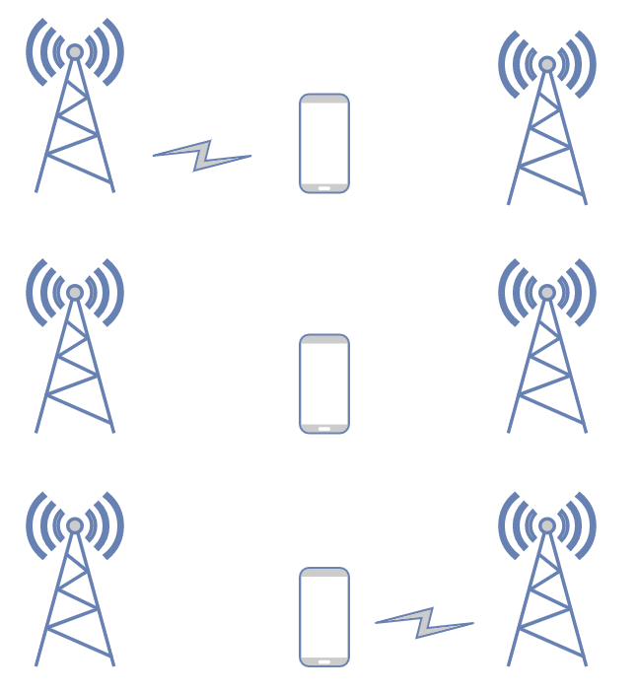
Hard Handover
Break before make
Cheaper & easier to implement
Generally completes in 100-200 ms
Mobile station hardware need not be capable of receiving >= 2 channels in parallel

Slide 11
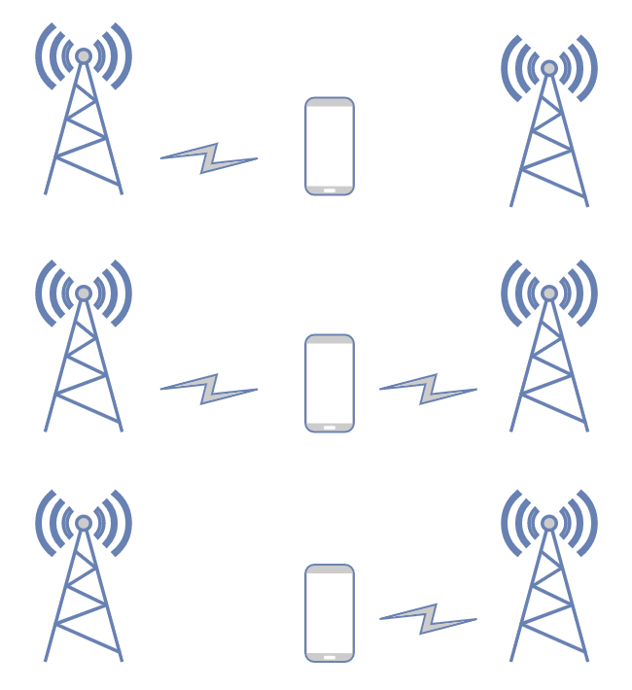
Soft Handover
Make before break
Mobile station is connected to >1 bases simultaneously
Better connection reliability
Expensive & complex
Mobile station hardware should be capable of receiving >= 2 channels in parallel

Slide 12
Roaming
State when mobile is being used outside its home network
Automatically connects to and makes use of services of visitor network
AAA
Authentication
Authorization
Accounting billing
Home network operator must have a roaming agreement with the visitor network operator

Slide 13
Roaming Process
Visitor network operator sees the device whenever powered on
VNO attempts to identify the HNO, if no roaming agreement then service is denied
VNO requests HNO for device/user identity using IMSI
VNO starts maintaining a temporary record of the user
HNO updates details so that further connections are routed to VNO

Slide 14
Attribute
Wi
-
Fi
4G
q
Purposefully designed
Equipment size
q
small
q
HUGE
Frequencies
2.4GHz & 5GHz
0.7
-
0.9, 1.6
-
q
q
1.9GHz
Range
q
Short
q
Long
Power usage
q
Very less
q
Very high
Speed
q
Fast
q
Comparatively slower
Application
In
-
q
home
q
On the go

Slide 15


Slide 16
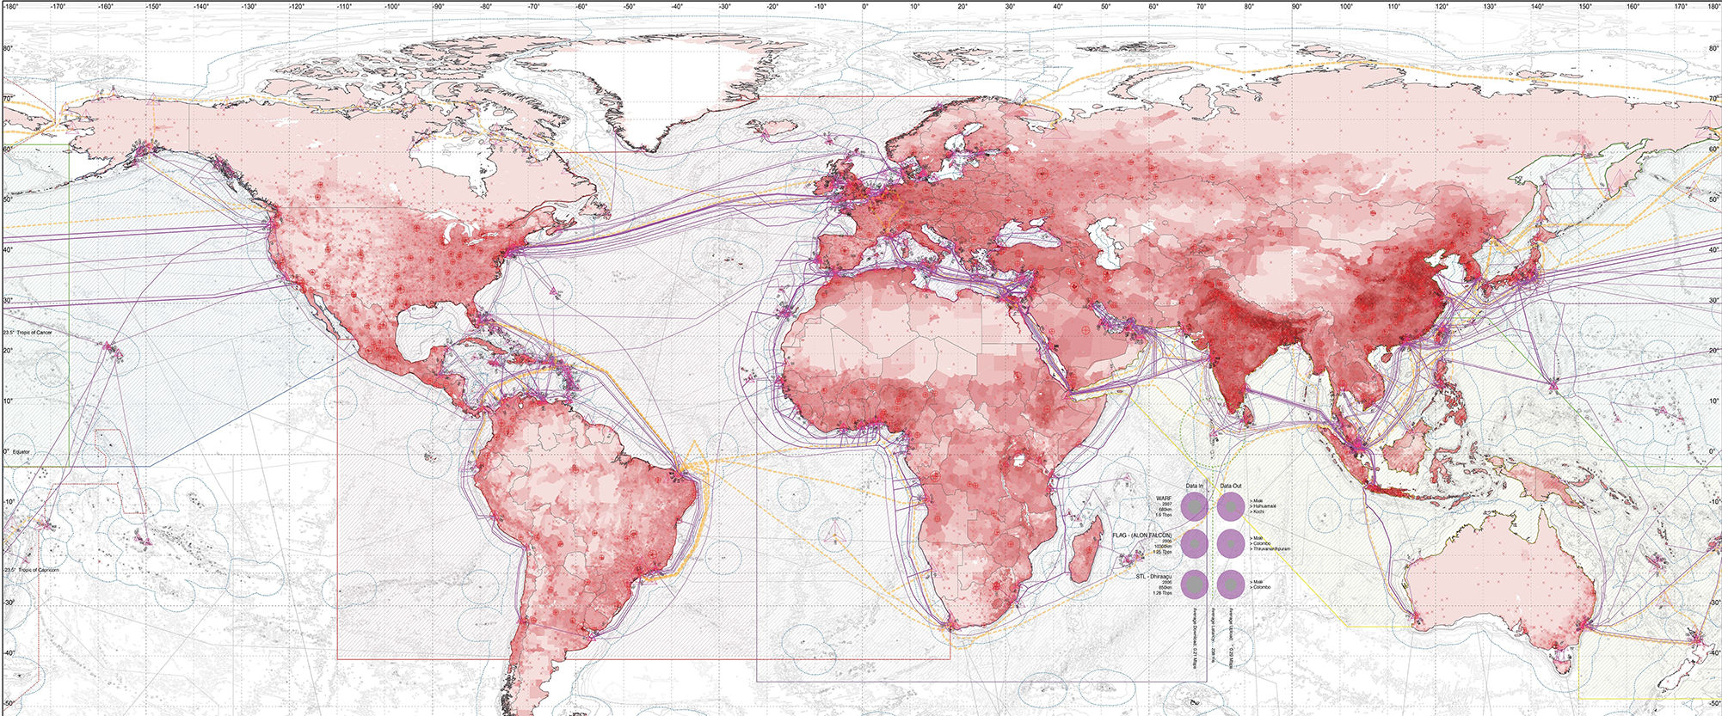
Image from VisualCapitalist

